Slide 1
Data Analysis
Wenbo ZHANG
School of Science, BUPT
zhangwb_wk@163.com

Slide 2
Preprocessing
Summarizing
Modeling
Course Project
CAUTION Keep two things in mind:
Describe the patterns in the data with simple models that lead to accurate predictions.
Understand the relationships among variables that lead to the model.

Slide 3
Preprocessing Data

Slide 4
Overview
Loading the Data
Missing Data
Outliers
Smoothing and *Filtering

Slide 5
Preprocessing Data Overview
Begin a data analysis by loading data into suitable MATLAB® container variables and sorting out the "good" data from the "bad." This is a preliminary step that assures meaningful conclusions in subsequent parts of the analysis.

Slide 6
Preprocessing Data Loading the Data
Begin by loading the data in count.dat:
load count.dat
The 24-by-3 array count contains hourly traffic counts (the rows) at three intersections (the columns) for a single day.

Slide 7
Preprocessing Data Missing Data
The MATLAB NaN (Not a Number) value is normally used to represent missing data. NaN values allow variables with missing data to maintain their structure—in this case, 24-by-1 vectors with consistent indexing across all three intersections.
Check the data at the third intersection for NaN values using the isnan function:
c3 = count(:,3); % Data at intersection 3
c3NaNCount = sum(isnan(c3))
c3NaNCount =
0
isnan returns a logical vector the same size as c3, with entries indicating the presence (1) or absence (0) of NaN values for each of the 24 elements in the data.

Slide 8
Preprocessing Data Outliers
Outliers are data values that are dramatically different from patterns in the rest of the data. They may be due to measurement error, or they may represent significant features in the data. Identifying outliers, and deciding what to do with them, depends on an understanding of the data and its source.
One common method for identifying outliers is to look for values more than a certain number of standard deviations σ from the mean μ.
The following code plots a histogram of the data at the third intersection together with lines at μ and μ + nσ, for n = 1, 2:

Slide 9
Preprocessing Data Outliers
bin_counts = hist(c3); % Histogram bin counts
N = max(bin_counts); % Maximum bin count
mu3 = mean(c3); % Data mean
sigma3 = std(c3); % Data standard deviation
hist(c3) % Plot histogram
hold on
plot([mu3 mu3],[0 N],'r','LineWidth',2) % Mean
X = repmat(mu3+(1:2)*sigma3,2,1);
Y = repmat([0;N],1,2);
plot(X,Y,'g','LineWidth',2) % Standard deviations
legend('Data','Mean','Stds')
hold off

Slide 10
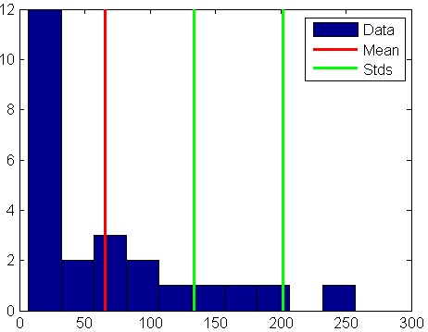
Preprocessing Data Outliers
The plot shows that some of the data are more than two standard deviations above the mean.

Slide 11
Preprocessing Data Outliers
If you identify these data as errors (not features), replace them with NaN values as follows:
outliers = (c3 - mu3) > 2*sigma3;
c3m = c3; % Copy c3 to c3m
c3m(outliers) = NaN; % Add NaN values

Slide 12
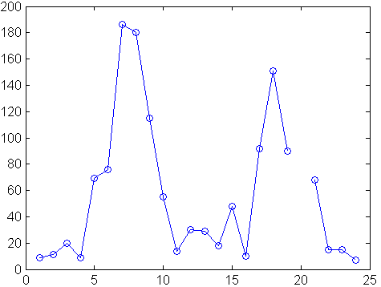
Preprocessing Data Smoothing and *Filtering
A time-series plot of the data at the third intersection (with the outlier removed in Outliers) results in the following plot:
plot(c3m,'o-')
hold on

Slide 13
Preprocessing Data Smoothing and *Filtering
The NaN value at hour 20 appears as a gap in the plot. This handling of NaN values is typical of MATLAB plotting functions.
Noisy data shows random variations about expected values. You may want to smooth the data to reveal its main features before building a model. Two basic assumptions underlie smoothing:
The relationship between the predictor (time) and the response (traffic volume) is smooth.
The smoothing algorithm results in values that are better estimates of expected values because the noise has been reduced.

Slide 14

Preprocessing Data Smoothing and *Filtering
Apply a simple moving average smoother to the data using the MATLAB convn function:
span = 3; % Size of the averaging window
window = ones(span,1)/span;
smoothed_c3m = convn(c3m,window,'same');
h = plot(smoothed_c3m,'ro-');
legend('Data','Smoothed Data')
CONVN N-dimensional convolution.

Slide 15
Preprocessing Data Smoothing and *Filtering
Smoothing estimates the center of the distribution of response values at each value of the predictor. It invalidates a basic assumption of many fitting algorithms, namely, that the errors at each value of the predictor are independent. Accordingly, you can use smoothed data to identify a model, but avoid using smoothed data to fit a model.

Slide 16
Summarizing Data

Slide 17
Overview
Measures of Location
Measures of Scale
Shape of a Distribution

Slide 18
Summarizing Data Overview
Many MATLAB® functions enable you to summarize the overall location, scale, and shape of a data sample.
One of the advantages of working in MATLAB is that functions operate on entire arrays of data, not just on single scalar values. The functions are said to be vectorized. Vectorization allows for both efficient problem formulation, using array-based data, and efficient computation, using vectorized statistical functions.

Slide 19
Summarizing Data Measures of Location
Summarize the location of a data sample by finding a "typical" value. Common measures of location or "central tendency" are computed by the functions mean, median, and mode(Most frequent values in array):
x1 = mean(count)
x2 = median(count)
x3 = mode(count)
Like all of its statistical functions, the MATLAB functions above summarize data across observations (rows) while preserving variables (columns).

Slide 20
Summarizing Data Measures of Scale
There are many ways to measure the scale or "dispersion" of a data sample. The MATLAB functions max, min, std, and var compute some common measures:
dx1 = max(count)-min(count)
dx2 = std(count)
dx3 = var(count)
Like all of its statistical functions, the MATLAB functions above summarize data across observations (rows) while preserving variables (columns).

Slide 21
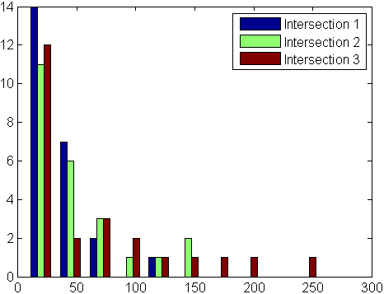
Summarizing Data Shape of a Distribution
The shape of a distribution is harder to summarize than its location or scale. The MATLAB hist function plots a histogram that provides a visual summary:
hist(count)

Slide 22
Summarizing Data Shape of a Distribution
Parametric models give analytic summaries of distribution shapes. Exponential distributions, with parameter mu given by the data mean, are a good choice for the traffic data:
c1 = count(:,1); % Data at intersection 1
[bin_counts,bin_locations] = hist(c1);
bin_width = bin_locations(2) - bin_locations(1);
hist_area = (bin_width)*(sum(bin_counts));
figure
hist(c1)
hold on
mu1 = mean(c1);
exp_pdf = @(t)(1/mu1)*exp(-t/mu1); % Integrates to 1
t = 0:150;
y = exp_pdf(t);
plot(t,(hist_area)*y,'r','LineWidth',2)
legend('Distribution','Exponential Fit')

Slide 23
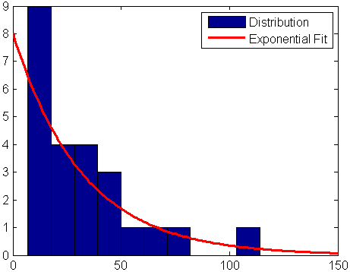
Summarizing Data Shape of a Distribution
Methods for fitting general parametric models to data distributions are beyond the scope of this cause. Statistics ToolboxTM software provides functions for computing maximum likelihood estimates of distribution parameters.

Slide 24
Modeling Data

Slide 25
Overview
Polynomial Regression
General Linear Regression

Slide 26
Overview
Parametric models translate an understanding of data relationships into analytic tools with predictive power. Polynomial and sinusoidal models are simple choices for the up and down trends in the traffic data.

Slide 27
Polynomial Regression
Parametric models translate an understanding of data relationships into analytic tools with predictive power. Polynomial and sinusoidal models are simple choices for the up and down trends in the traffic data.
Use the polyfit function to estimate coefficients of polynomial models, then use the polyval function to evaluate the model at arbitrary values of the predictor.
The following code fits the traffic data at the third intersection with a polynomial model of degree six:

Slide 28
Polynomial Regression
c3 = count(:,3); % Data at intersection 3
tdata = (1:24)';
p_coeffs = polyfit(tdata,c3,6);
figure
plot(c3,'o-')
hold on
tfit = (1:0.01:24)';
yfit = polyval(p_coeffs,tfit);
plot(tfit,yfit,'r-','LineWidth',2)
legend('Data','Polynomial Fit','Location','NW')

Slide 29
General Linear Regression
Assuming that the data are periodic with a 12-hour period and a peak around hour 7, it is reasonable to fit a sinusoidal model of the form:
The coefficients a and b appear linearly. Use the MATLAB® mldivide (backslash) operator to fit general linear models:

Slide 30
General Linear Regression
c3 = count(:,3); % Data at intersection 3
tdata = (1:24)';
X = [ones(size(tdata)) cos((2*pi/12)*(tdata-7))];
s_coeffs = X\c3;
figure
plot(c3,'o-')
hold on
tfit = (1:0.01:24)';
yfit = [ones(size(tfit)) cos((2*pi/12)*(tfit-7))]*s_coeffs;
plot(tfit,yfit,'r-','LineWidth',2)
legend('Data','Sinusoidal Fit','Location','NW')

Slide 31
Course Project
The End

